Slide 1
Analysis of yearly members and casual riders
By Hana

Slide 2
How do annual members and casual riders use Cyclistic bikes differently?
Analysis on a year’s worth of data from Cyclistic (Feb 2023 - Jan 2024)
Cleaned, processed and formatted on Power Query through Excel
Patterns found using Pivot Table through Excel
What is the difference between these two types of riders and what can we learn from this to gain more annual members?

Slide 3
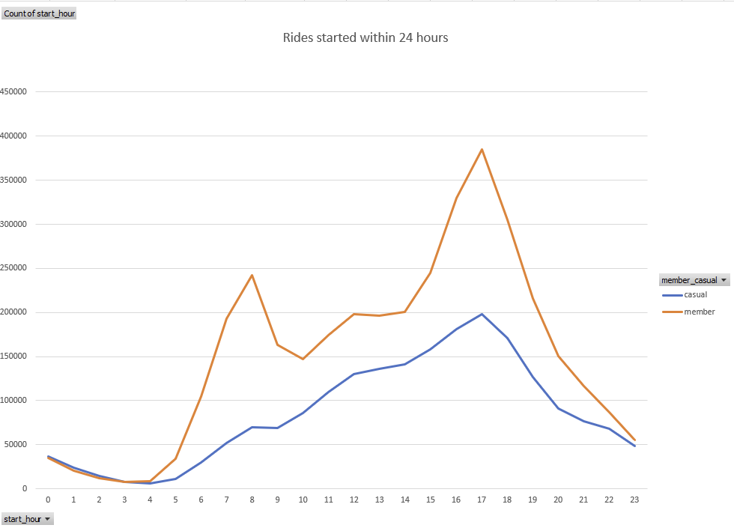
Purpose of their ride
Members use our bikes as a means of transportation to and from work
Sharp peak at around 8am and 5pm
Weaker peak for casual members
They ride casually!
Are some casual riders using our bikes for their work commute just like our annual members?

Slide 4
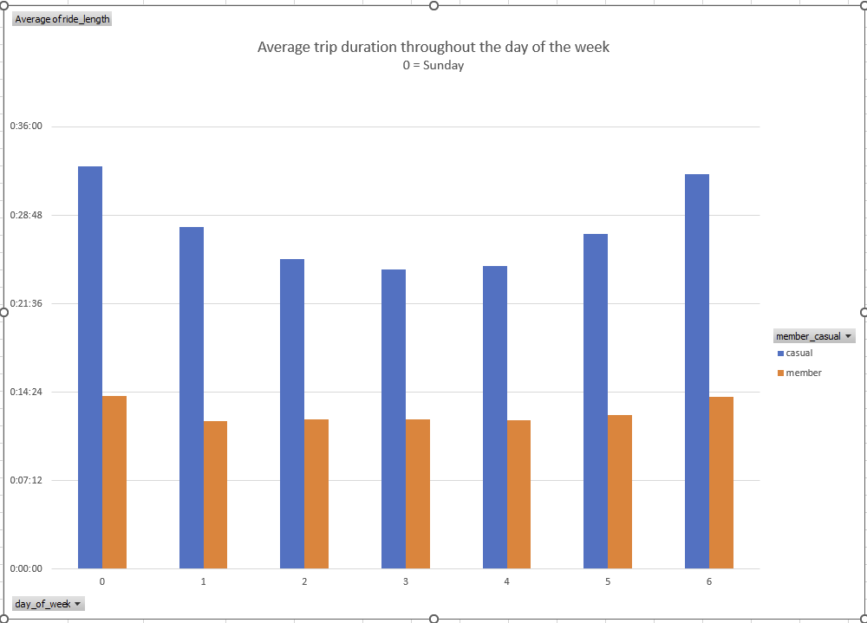
Trip duration reflecting their purpose
Yearly members use our services at a consistent length from Mon. thru Fri..
Reinforces the idea of using the bikes for their work commute
Casual riders tend to ride our bikes more casually so no clear patterns
They clearly ride a lot longer than members, though!

Slide 5
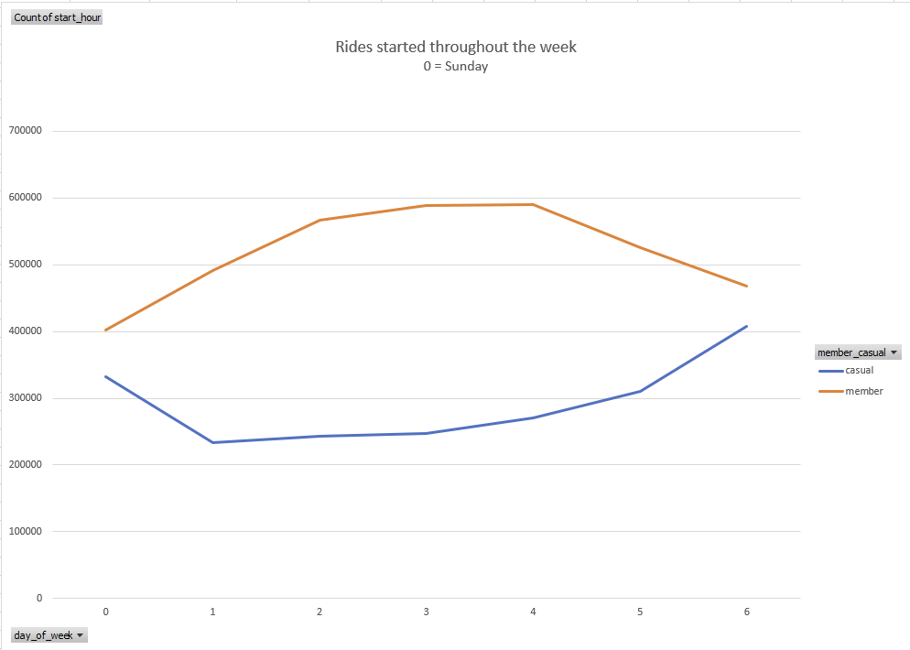
Why do they ride?
Casual weekend rider spikes (Sat and Sun)
As a leisurely weekend activity
Annual members have an extended spike throughout weekday
Commuting for work, not so for leisure

Slide 6
Conclusion
Many annual members use the bikes for their work commutes
Not so much for leisurely purposes
Casual riders use the bikes for their enjoyment and tend to use the bikes longer in duration
Good number of casual members also use our services for commuting
Can we promote the idea of using our bikes for commuting for work?
Let’s make some accommodations on our bikes during colder, off seasons

Slide 7
Sources
https://divvy-tripdata.s3.amazonaws.com/index.html

